Slide 1
Introduction
Notes:
Slides from Erik Poll，Radboud University Nijmegen

Slide 2
Today
What is “software security”?
The problem of software insecurity
The causes of the problem
Security concepts
The solution to the problem?

Slide 3
Motivation

Slide 4
Quiz
What do web-sites, web-browsers, operating systems, wifi access points, network routers, mobile phones, PDAs, smartcards, firewalls, intrusion detection systems, and video-conferencing equipment have in common?
SOFTWARE!
Why can all these things be hacked, if we are not very careful?

Slide 5
Why a course on software security?
Software plays a major role in providing security, and is a major source of security problems.
Software is the weakest link in the security chain, with the possible exception of “the human factor”
Software security does not get much attention
in other security courses, or
in programming courses,
or indeed, in much of the security literature!

Slide 6
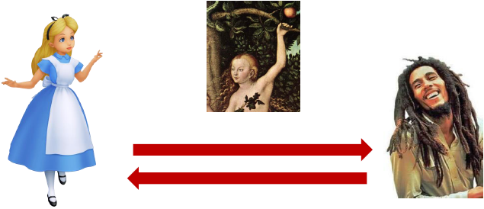
Fairy tales: a problem...
Many discussions of security begin with Alice and Bob
How can Alice communicate securely with Bob,
when Eve can modify or eavesdrop on the communication?

Slide 7
This is an interesting problem,
but it is not the biggest problem

Slide 8
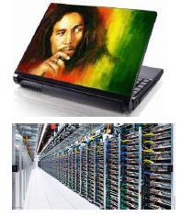
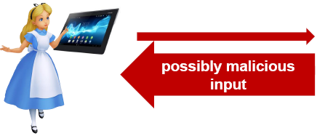
Reality & the bigger problem
Alice’s computer is communicating with some other computer on the internet
How can we prevent Alice’s computer from being hacked, when it communicates with some other computer?
solving the first problem - securing the communication -does not help here!

Slide 9
We focus on software security, but don’t forget that security is about, in no particular order,
people(users, employees, sys-admins, programmers,...), access control, passwords, biometrics, cryptology, protocols, policies & their enforcement, monitoring, auditing, legislation, persecution, liability, risk management, incompetence, confusion, lethargy, stupidity, mistakes, complexity, software, bugs, verification, hackers, viruses, hardware, operating systems, networks, databases, public relations, public perception, conventions, standards, physical protection, data protection,...

Slide 10
The problem

Slide 11
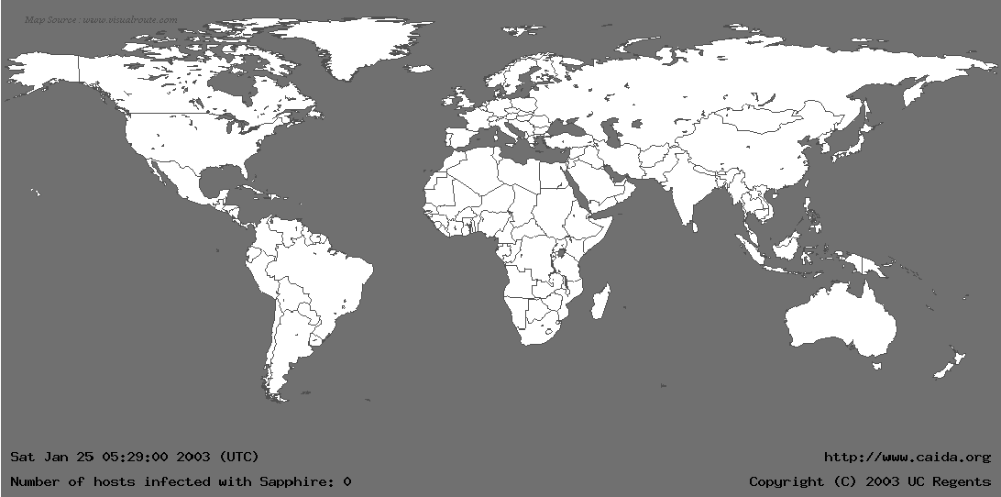
Slammer Worm

Slide 12
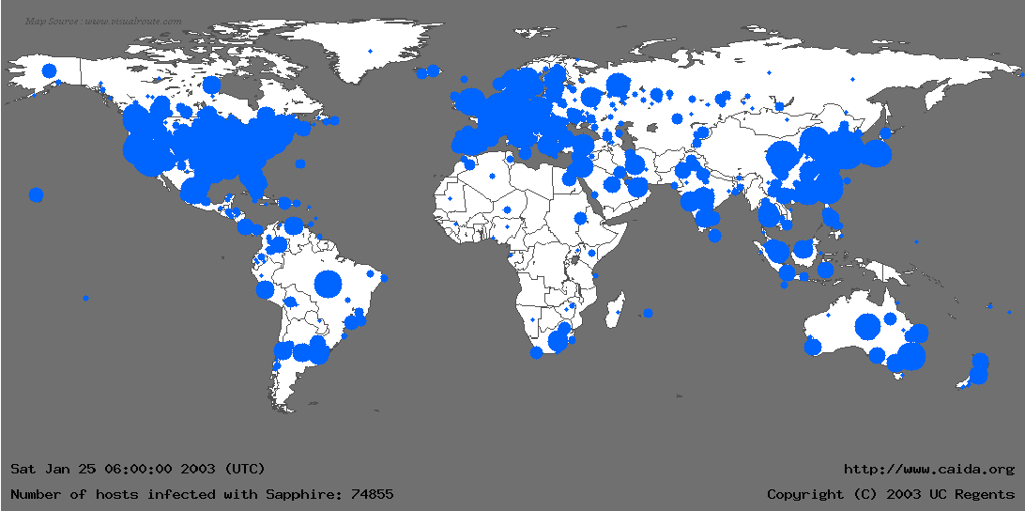
Slammer Worm

Slide 13
Superficial analysis of the problem

Slide 14
Observation 1
All these problems are due to (bad) software
Namely
the Linux/Windows/Mac/… Operating System (OS)
web browser or web application
graphics software, for Quicktime, Adobe Flash, PDF ..
the router software
the videoconferencing system software
…
Such software bugs are why constant patching of system is needed to keep them secure

Slide 15
Observation 2
All these problems are due to bad software that
can be executed/addressed over the network (e.g., Slammer worm)
executes on (untrusted) input obtained over the network (e.g., pdf viewers, routers)
or –in the worst case –both
With ever more network connectivity, ever more software can be attacked.

Slide 16
Changing target of attacks
Traditionally, focus on operating system and network
“Solutions”
regular patching of OS, firewalls, virus scanners
Increasingly, focus on
web applications
web browser
mobile devices (smartphones, tablets)
embedded software (software in cars, factories, critical infrastructure)
and targeted attacks on specific organization or person (APT)

Slide 17
Changing nature of attackers
Traditionally, hackers are amateurs motivated by fun
publishing attacks for the prestige
Increasingly, hackers are professional
attackers go underground
zero-day exploits are worth money
attackers include
organized crime: with lots of money and (hired) expertise
government agencies: with even more money & in-house expertise

Slide 18
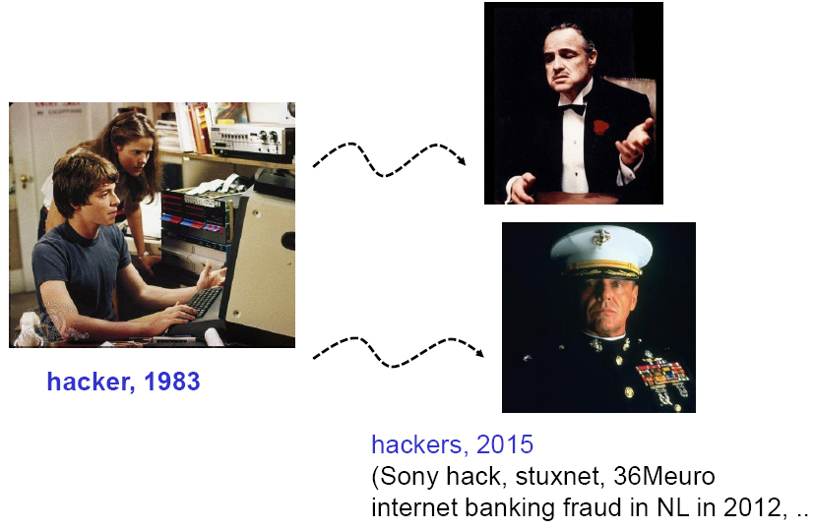
Changing nature of attackers

Slide 19
Software (in)security: crucial facts
No silver bullets!
Crypto or special security features do not magically solve all problems
software security ≠ security software
“if you think your problem can be solve by cryptography, you do not understand cryptography and you do not understand your problem” [Bruce Schneier]
Security is emergent property of entire system
just like quality
(Non-functional) security aspects should be integral part of the design, right from the start
Notes:
Bruce Schneier (/ˈʃnaɪər/; born January 15, 1963^{[1]}) is an American cryptographer, computer security and privacy specialist, and writer.

Slide 20
The causes of the problem

Slide 21
Quick audience poll
How many of you learned to program in C or C++?
~ as a first programming language?
How many of these courses
warned you about buffer overflows?
explained how to avoid them?
Major causes of problems are
lack of awareness
lack of knowledge
irresponsible teaching of dangerous programming languages

Slide 22
Quick audience poll
How many of you have built a web-application?
in which programming languages?
What is the secure way of doing a SQL query in this language? (to avoid SQL injection flaws)
Major causes of problems are
lack of awareness
lack of knowledge

Slide 23
Security is always a secondary concern
Security is always a secondary concern
primary goal of software is to provide some functionality or services; managing associated risks is a derived/secondary concern
There is often a trade-off/conflict between
security
functionality & convenience
where security typically looses out
more examples of this later...

Slide 24
Functionality vs security
Functionality is about what software should do, security is (also) about what it should not do
Unless you think like an attacker, you will be unaware of any potential threats

Slide 25
Functionality vs security: Lost battles?
operating systems (OSs)
with huge OS, with huge attack surface
programming languages
with easy to use, efficient, but very insecure and error-prone mechanisms
Web browsers
with plug-ins for various formats, javascript, ActiveX, Flash,
email clients
which automatically cope with all sorts of formats & attachments..
Notes:
All kinds of software contains more and more functionalities, however, becomes more and more vulnerable.

Slide 26
Functionality vs security : PHP
"After writing PHP forum software for years, I've come to the conclusion that it is basically impossible for normal programmers to write secure PHP code. It takes far too much effort. .... PHP's raison d'etre is that it is simple to pick up and make it do something useful. There needs to be a major push ... to make it safe for the likely level of programmers -newbies. Newbies have zero chance of writing secure software unless their language is safe. ... "
[Source http://www.greebo.cnet/?p=320]
Notes:
PHP is more safer than C/C++

Slide 27
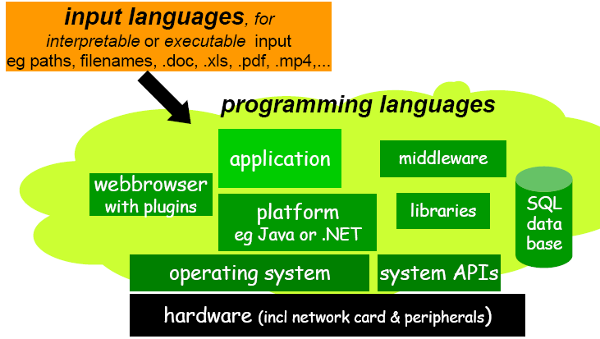
Weakness in depth
Notes:
Software weakness sits in all layers of software stack.

Slide 28
Weakness in depth
Software
runs on a huge, complicated infrastructure
HW, OS, platforms, web browser, lots of libraries & APIs, ...
is built using complicated languages
Programming languages (incl. machine code) and input languages (SQL, HTML, XML, mp4, …)
using various tools
compilers, IDEs, preprocessors, dynamic code downloads
These may have security holes, or may make the introduction of security holes very easy & likely

Slide 29
Recap
Problems are due to
lack of awareness
of threats, but also of what should be protected
lack of knowledge
of potential security problems, but also of solutions
compounded by complexity
software written in complicated languages, using large APIs , and running on huge infrastructure
people choosing functionality over security

Slide 30
“is this system secure?”
“this system is secure”
Why are the question and the claim above meaningless?
Notes:
We will show that we cannot find an answer to the question, and the question itself may be meaningless

Slide 31
Software and Security
Security is about regulating access to assets
eg. information or functionality
Software provides functionality
eg on-line exam results
This functionality comes with certain risks
eg what are risks of on-line exam results?
(Software) security is about managing these risks

Slide 32
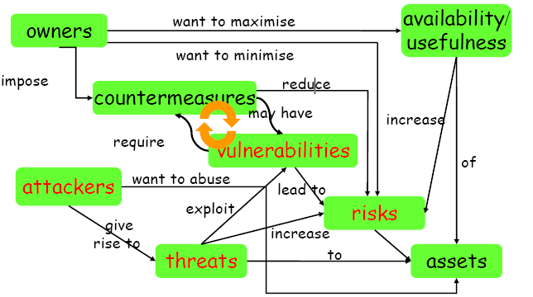
Security concepts

Slide 33
Starting point for ensuring security
Any discussion of security should start with an inventory of
the stakeholders,
their assets, and
the threats to these assets
by possible attackers
attacker model, which may include employees, clients, script kiddies, criminals, NSA, or other APTs (Advance Persistent Threats)
Any discussion of security without understanding these issues is meaningless

Slide 34
Security concepts
Security is about imposing countermeasures to reduce risks to assets to acceptable levels
A security policy is a specification of what security requirements/goals the countermeasures are intended to achieve
secure against what and from whom ?
Security mechanisms to enforce the policy
Bottlenecks:
expressing what we (don't) want in a policy
enforcing this, dynamically or statically

Slide 35
Security Objectives: CIA
Confidentiality
unauthorised users cannot read information
Integrity
unauthorised users cannot alter information
Availability
authorised users can access information
Non-repudiation for accountability
authorised users cannot deny actions
Notes:
CIA + non-reputation for accountability

Slide 36
Security objectives
Integrity nearly always more important than confidentiality
Eg think of
your bank account information
your medical records
all the software you use, incl. the entire OS
Availability may be undesirable for privacy
you want certain data to be or become unavailable

Slide 37
Security goals
The well-known trio
confidentiality, integrity, authentication (CIA)
but there are more “concrete” goals
traceability and auditing (forensics)
monitoring (real-time auditing)
multi-level security
privacy & anonymity
…
and meta-property
assurance – that the goals are met

Slide 38
How to realise security objectives? AAAA
Authentication
who are you?
Access control/Authorisation
control who is allowed to do what
this requires a specification of who is allowed to do what
Auditing
check if anything went wrong
Action
if so, take action

Slide 39
How to realise security objectives?
Other names for the last three A's
Prevention
measures to stop breaches of security goals
Detection
measures to detect breaches of security goals
Reaction
measures to recover assets, repair damage, and persecute (and deter) offenders
don't ever be tempted into thinking that good prevention makes detection & reaction superfluous.
Eg. breaking into any house with windows is trivial; despite this absence of prevention, detection & reaction still deter burglars.

Slide 40
Threats vs security requirements
information disclosure
confidentiality
tampering with information
integrity
denial-of-service (DoS)
availability
spoofing
authentication
unauthorised access
access control

Slide 41
Countermeasures
Countermeasures can be non-IT related
physical security of building
screening of personnel
legal framework to deter criminals
police to catch criminals
...
but we won’t consider these

Slide 42
Software security

Slide 43
warning: confusing terminology
Common use of terminology can be very confused & confusing: (security) weakness, flaw, vulnerability, bug, error, coding defect...
We can make a distinction between
a security weakness/flaw: something that is wrong or could be better
a security vulnerability: a weakness/flaw that can actually be exploited by an attacker, which requires the flaw to be
accessible: attacker has to be able to get at it
exploitable: attacker has to be able to do some damage with it
E.g. by unplugging your network connection, some (many?) vulnerabilities become flaws.

Slide 44
software vulnerabilities
Software vulnerabilities can be introduced at two “levels”
design flaws: vulnerability in the design
bugs aka implementation flaws or code-level defects: vulnerability in the software introduced when implementing a system
Rough consensus: bugs and design flaws are equally common
Vulnerabilities also arise on other levels (out of scope for now)
configuration flaw when installing software on a machine
The user
unforeseen consequence of the intended functionality (e.g. spam)

Slide 45
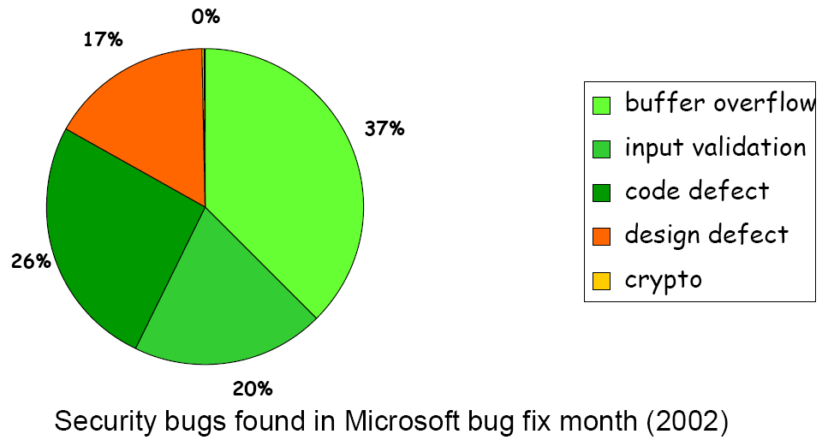
Typical software security vulnerabilities

Slide 46
bugs aka implementation flaws aka code-level defects
There are roughly two kinds of implementation flaws
bugs that can be understood looking at the program itself (and understanding what it is meant to do!)
E.g. , simple typos, confusing two program variables, off-by-one error in array access, ...
sometimes called logic errors, as opposed to syntax errors, or an errors in the program logic
lower-level problems that can only be spotted if you understand the underlying platform or other languages/systems the program interacts with, e.g
buffer overflow, integer overflow,...in binaries compiled from C(++)
SQL injection, XSS, CSRF,.... in web-applications

Slide 47
The dismal state of software security
The bad news
people keep making the same (types of) mistakes
The good news
people keep making the same (types of) mistakes
…… so we can do something about it!
“Every upside has its downside” [Johan Cruijff]

Slide 48
We need a wider view of security throughout the software development life cycle
Notes:
From design, development, testing to deploying

Slide 49
Tackling software Insecurity
Knowledge about standard mistakes is crucial in preventing them
these depends on the programming language, the “platform”(OS, database systems, web-application framework,…), and the type of application
lots of info available on this now
But this is not enough: security to be taken into account from the start, throughout software development life cycle
several ideas & methodologies to do this

Slide 50
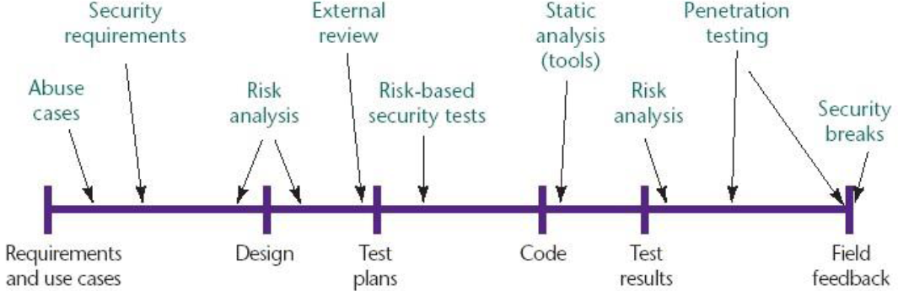
Security in Software Development Life Cycle
McGraw’s Touchpoints

Slide 51
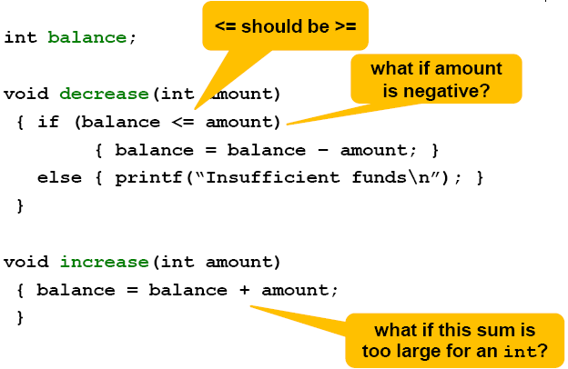
Spot the (security) flaws in electronic_purse.c

Slide 52



Different kinds of implementation flaws
possible lack of input validation of (untrusted) user input
could be a design flaw rather than an implementation flaw?
more “fundamental” than the flaws below
simple mistake in the program logic
potential problem depending on how the underlying platform work, eg. in case of an integer overflow;
“Lower level” than the flaws above

